Slide 1
WEB DEVELOPMENT
Lecture 01
Mark-Up Languages

Slide 2
What is a Web Server?
http://www.bpc.ac.uk/staff/kevin.htm
Web Server
GET /staff/kevin.htm HTTP/1.1
Host: www.bpc.ac.uk
Path
translation
Internet
<html>
<body>
Hello world
</body>
</html>
Kevin.htm
C:\inetpub\wwwroot\staff\kevin.htm

Slide 3
What is HTML?
Webpages are mostly written in HTML.
This stands for:
Hyper
Text
Markup
Language

Slide 4
Example of HTML
<html> <head>
<title>My Sample Page</title>
</head>
<body bgcolor="yellow"> <h1>This is the big title</h1> <hr> <p>This is a paragraph of text which is going to appear on the web page. It is really only being used to demonstrate the way in which you can construct web pages and so it isn't really worth reading what it says, because it is very boring.</p> </body> </html>

Slide 5
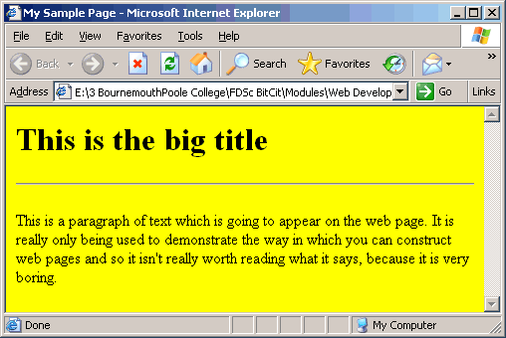
When displayed in a browser….

Slide 6
Note that….
The markup consists of a set of tags, or elements.
<title> <p> <h1>
Each opening tag has a closing tag
<html> </html> <body> </body>
Some tags have attributes, which can be given values.
<body bgcolor="yellow">
bgcolor is actually an out of date, deprecated attribute, which is no longer used.

Slide 7
What is Hypertext?
"Hypertext is text which is not constrained to be linear.
Hypertext is text which contains links to other texts. The term was coined by Ted Nelson around 1965.
HyperMedia is a term used for hypertext which is not constrained to be text: it can include graphics, video and sound , for example. Apparently Ted Nelson was the first to use this term too.
Hypertext and HyperMedia are concepts, not products."
Taken from www.w3.org/whatis.html - (9/8/07)

Slide 8
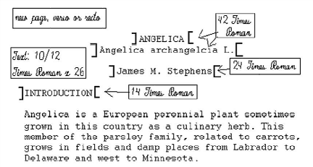
What is a Markup Language?
Printers used to mark up a paper manuscript with symbols to indicate what typeface, size and style should be used to layout the page.

Slide 9
What is a Markup Language?
Standardised General Markup Language (SGML) developed by IBM in the 1960s as a way of encoding data. Used for
Boeing Aircraft Technical Documentation
Oxford English Dictionary (2nd edition)
Very complex set of tags and rules, which are laid out in a Document Type Definition (DTD).

Slide 10
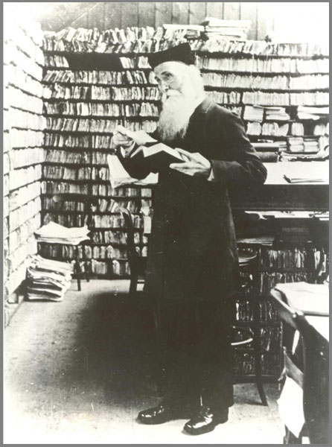
Oxford English Dictionary
First edition started 1857
They thought it would take 10 years to finish.
By 1888 they had not got very far.
First edition was fully published in 1933.
By 1950, they realised that they needed to start work on the second edition.

Slide 11
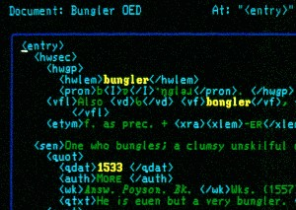
Example of an OED entry in SGML
Taken from: http://en.wikipedia.org/wiki/Sgml – (16/8/07)

Slide 12
History of HTML
1980s Computers are all text-based, with a command line interface.
1990 Tim Berners-Lee develops an in-house document sharing system for use at CERN. It includes the first version of:
HTML (based on SGML)
HTTP, a protocol for transmitting HTML documents
A GUI browser which he calls 'WorldWideWeb'.

Slide 13
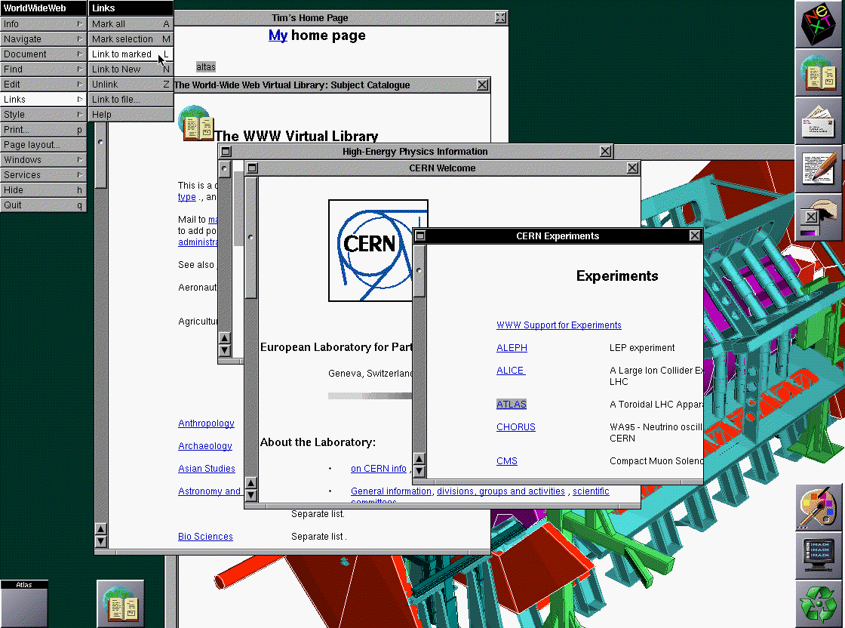
Screenshot from Berners-Lee's Computer
Taken from: http://www.w3.org/History/1994/WWW/Journals/CACM/screensnap2_24c.gif - (16/8/07)

Slide 14
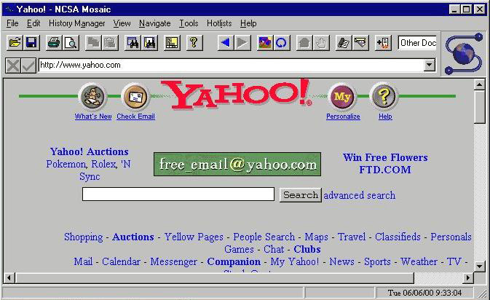
1993
Mosaic, a GUI web browser, written by Marc Andreessen and Eric Bina at NCSA, spreads like wildfire through the global academic community.
Taken from http://www.computerhistory.org/timeline/images/1993_mosaic_browser_large.jpg

Slide 15
1994
Tim Berners-Lee leaves CERN and sets up the World Wide Web Consortium (W3C).
An organisation which starts trying to develop standards for web based technologies.
But this takes time. It is not until:
1995 HTML v3.0
1996 CSS v1
are published.
In the meantime….

Slide 16
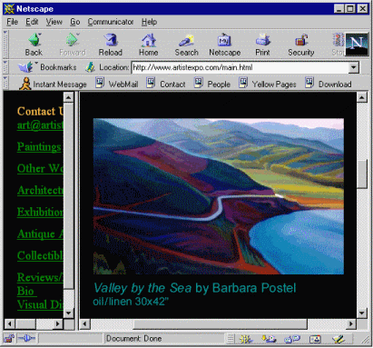
1994
Andreessen forms the company 'Netscape' which produces a browser called 'Mozilla', later called 'Netscape Navigator'.
Taken from http://www.answers.com/topic/netscape-navigator - (16/8/07)

Slide 17
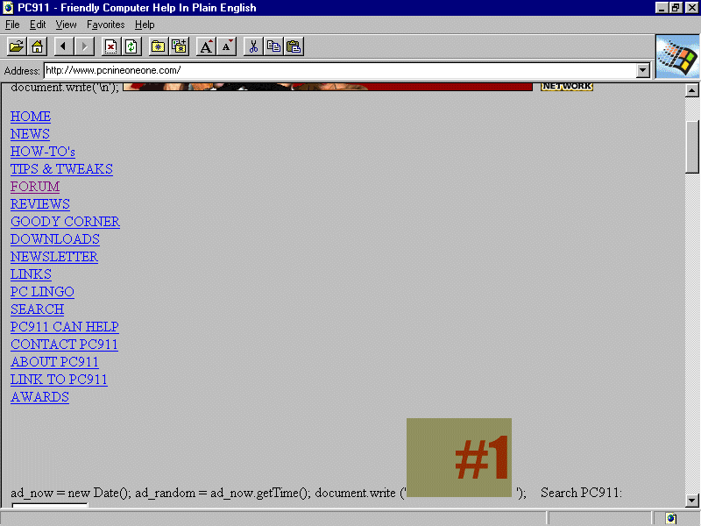
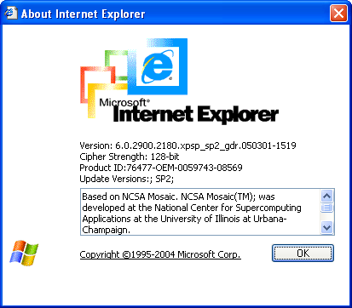
1995
Microsoft produces Internet Explorer v1 and ships it with Windows 95.
Internet use enters the mainstream.
Taken from http://www.pcqanda.com/dc/dcboard.php?az=printer_friendly&forum=2&topic_id=457969

Slide 18
The Browser Wars 1995 - 2000
Microsoft and Netscape fight for market share, trying to make sure their browser is the most widely used. As a result:
They tend to add new features instead of fixing bugs.
They add proprietry features instead of obeying standards.
HTML development is fairly chaotic during these five years.
There are lots of different versions of HTML around.
They are not always compatible.
The browser manufacturers try to make HTML do things that it was never meant to do.
Microsoft wins and in 2000 Netscape is sold off to AOL.

Slide 19
Bad HTML
<HTML>
<HEAD>
<TITLE>My Sample Page</TITLE>
</HEAD>
<BODY BGCOLOR=#FFCC00>
<P>
<H1><FONT COLOR=RED>
<U>These are physical styles</FONT></U>
</H1><BR>
<TT>This is in typewriter style.</TT><BR>
<BLINK><I>This is in italic.</I></BLINK><BR>
<STRIKE>This is in strikeout style.</STRIKE>
<BR>
<B><FONT SIZE=20>This is in boldface.</FONT></B>
<BR>
<U>This is in underline style</U><BR>
</P>
</BODY>
</HTML>

Slide 20
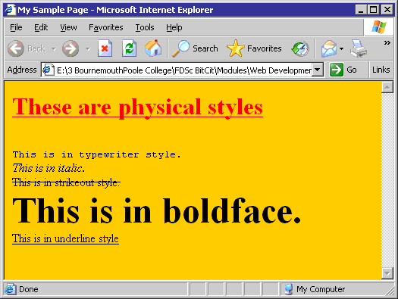
Which looks like this:

Slide 21
Constructing a Webpage
The Structural Layer
What it is
XHTML
The Presentation Layer
What it looks like
Cascading Style Sheets (CSS)
The Behavioural Layer
What it does
JavaScript (or similar scripting language)

Slide 22
Keep Them Separate
A well designed website will keep the three types of code in separate files – or even separate folders.
graphic1.jpg
graphic2.gif
stylesheet1.css
styleform.css
functions.js
images
css
scripts
index.htm
page1.htm
page2.htm
images
css
scripts
pageA.htm
pageB.htm
website01
website02

Slide 23
HTML vs XHTML
Most browsers will allow you to write lazy HTML.
You can:
Use tags that control how the document looks
Mix upper and lower case element names.
Leave quotes off attribute values.
Not bother with some closing tags.
Leave off some attribute values.
Not bother to nest all elements correctly.

Slide 24
In XHTML you must always…
Use lower case for all element and attribute names.
Put quotes around attribute values (even single words and numbers).
Terminate elements….
…Even empty elements. (<br /> or <br></br>)
Use explicit attribute values (checked="checked").
Make sure that all elements are nested correctly.
Use the id attribute in preference the name attribute.
Place CSS and Scripts in their own files.
XHTML is a more rigorous, precise version of HTML.

